Slide 1
The Value of Nothing: How Patience is Increased by Making Later Opportunity Costs Salient
David J. Hardisty
UBC-UW Conference 2014
Notes:
Images from unsplash.com

Slide 2
Outline
Complain about Darren Dahl
8 studies about nothing: the true story
3 studies about something (but we aren't sure quite what yet)

Slide 3
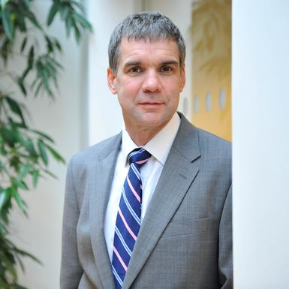
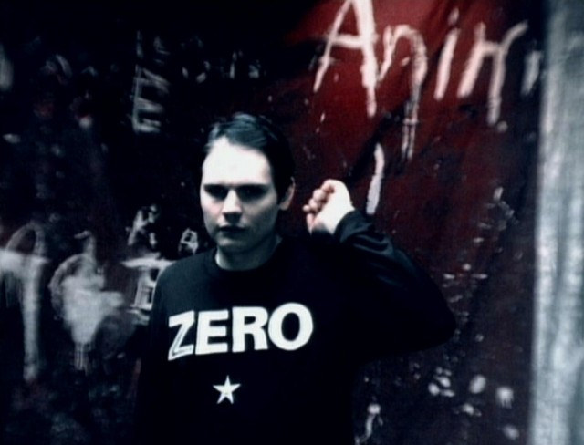
8 studies about nothing
Daniel Read
WBS
Christopher Olivola
CMU
Billy Corgan

Slide 4
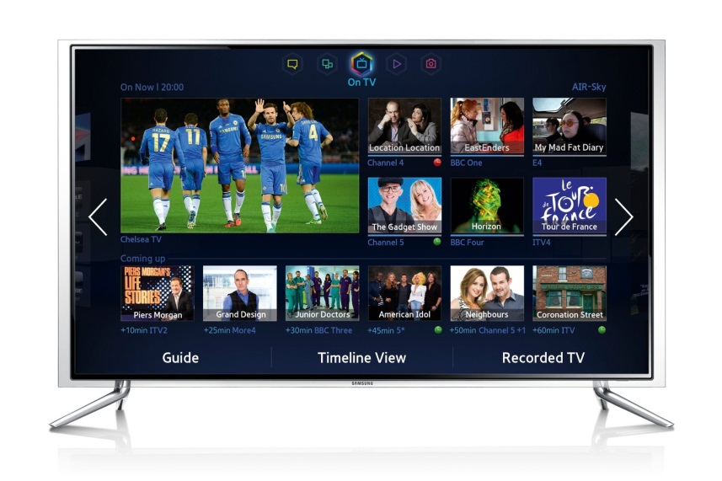
Consumer choices and opportunity costs
But forego the bigger pension.
But forego the big TV.
SOME YEARS HENCE
NOW
Notes:
Image from unsplash.com
Consumer decision making concerns opportunity costs. People seek to attain the best possible distribution of their scarce resources.
Patience is the willingness to forego earlier opportunities to attain larger but later ones.
Choosing between TV now, and Pension plan some years hence.
All choices have this nature, because by definition taking something means giving up something else.
When making the choice of the TV you might not give sufficient weight to the future pension plan, and when making the pension plan choice you might not give sufficient weight to the TV.
Suppose that I nudge you by reminding you what you give up if you take the future pension plan.
And by reminding you what you give up by taking the TV.
The pension plan nudge should make the pension seem worse (or equivalently make the TV seem better). The TV nudge has a corresponding effect on the TV.
The ultimate result is indeterminate. So what will happen?

Slide 5
The “Hidden Zero” Effect (Magen, Dweck & Gross; 2008)
Standard choices between smaller-sooner (SS) and larger-later (LL) rewards.
Respondents explicitly reminded of both opportunity costs
$100 now
$150 in one year
and $0 in one year
$0 now and
Patience increased

Slide 6
Why does this happen?
Could it be a sequence effect?
Comparative value effect (magnitude)?
Opportunity cost?
$100 now and $0 in one year OR $0 in now and $150 in one year

Slide 7
Study 1: Conditions
Hidden zero: $5.50 now OR $7.50 in 61 days
LL zero: $5.50 now OR $0 in now and $7.50 in 61 days
SS zero: $5.50 now and $0 in 61 days OR $7.50 in 61 days
Explicit zero (both LL and SS): $5.50 now and $0 in 61 days OR $0 in now and $7.50 in 61 days

Slide 8
Study 1: Methods
610 participants recruited through Maximiles
15 hypothetical intertemporal choices
DV: proportion of LL choices (patience)

Slide 9
Study 1: Methods
610 participants recruited through Maximiles
15 hypothetical intertemporal choices
DV: proportion of LL choices (patience)

Slide 10
Study 1 Results
Notes:
Discount rates reduced from around 400% to around 250%

Slide 11
Study 1: Results
Hidden zero: $5.50 now OR $7.50 in 61 days
LL zero: $5.50 now OR $0 in now and $7.50 in 61 days
SS zero: $5.50 now and $0 in 61 days OR $7.50 in 61 days
Explicit zero (both LL and SS): $5.50 now and $0 in 61 days OR $0 in now and $7.50 in 61 days
Sequences? Comparison? Opportunity cost?

Slide 12
Study 1: Conditions
Middle zero: $5.50 now and $0 in 30 days OR $0 in 30 days and $7.50 in 61 days

Slide 13
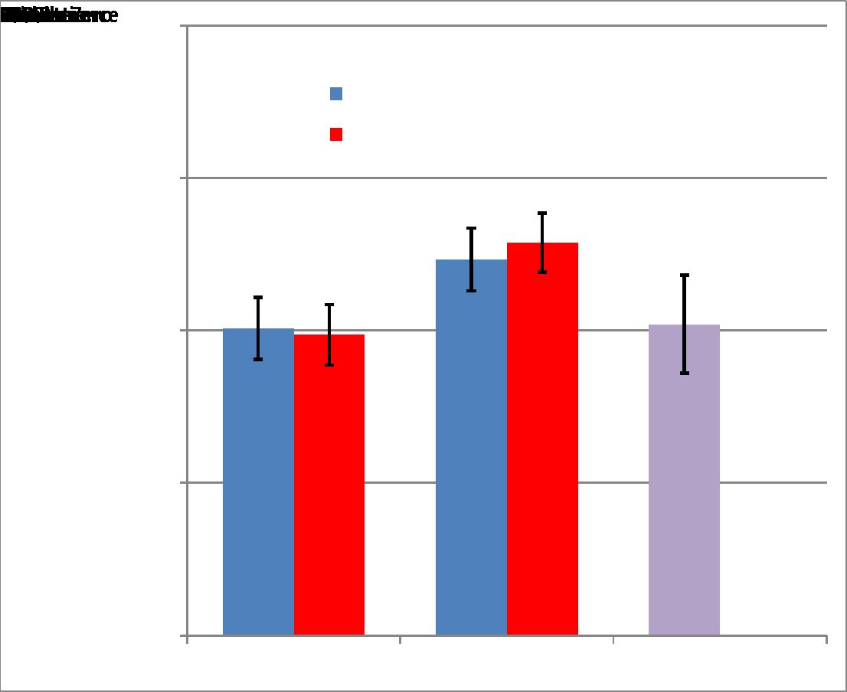
Study 1 Results
NO effect of LL zero
SS zero does all the work.
NO effect of Middle zero
SS zero
Hid-
den
Ex-plicit
Middle
LL zero

Slide 14
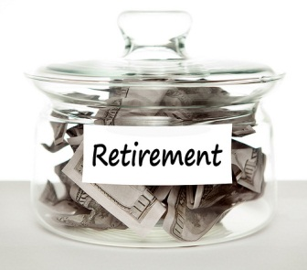
Preliminary interpretation
Reminding people that if they wait they won’t get something now has no effect – they already know this.
But reminding them that if they don’t wait they won’t get something later – that is not so obvious.

Slide 15
Mediating, Moderating, & Generalizing
Study 2: Magnitude
Study 3: “Now” effect
Study 4: Losses
Study 5a: Within subjects
Study 5b: Lay predictions
Study 6: Thought listings
Study 7: Implicit process measure (RTs)
Study 8: Real outcomes

Slide 16
Study 2: Magnitude
Used validated choice pairs from Kirby, Petry, & Bickle (1999), which incorporate magnitude:
Small: £25 today OR £30 in 80 days
Medium: £49 today OR £60 in 89 days
Large: £69 today OR £85 in 91 days
Prediction: Maybe our effect will get smaller at larger magnitudes

Slide 17
Study 2 Results
 | Magnitude
Zero Condition | Small | Medium | Large | N
Explicit | .53 | .58 | .61 | 58
SS zero | .54 | .60 | .61 | 55
LL zero | .42 | .48 | .49 | 50
Hidden | .40 | .43 | .48 | 47
Kirby et al. (1999) | .35 | .41 | .46 | 60

Slide 18
Mediating, Moderating, & Generalizing
Study 2: Magnitude – robust!
Study 3: “Now” effect
Study 4: Losses
Study 5a: Within subjects
Study 5b: Lay predictions
Study 6: Thought listings
Study 7: Implicit process measure (RTs)
Study 8: Real outcomes

Slide 19
Study 3: “Now”
Perhaps there’s something special about “now”, driving the asymmetry
Today-SS: £5.50 today and £0 in 61 days OR £0 today and £7.50 in 61 days
Delayed-SS: £5.50 in 61 days and £0 in 122 days OR £0 in 61 days and £7.50 in 122 days
Prediction: effect will disappear in delayed-SS condition (alternative is ASAP effect, Kable & Glimcher 2010)

Slide 20
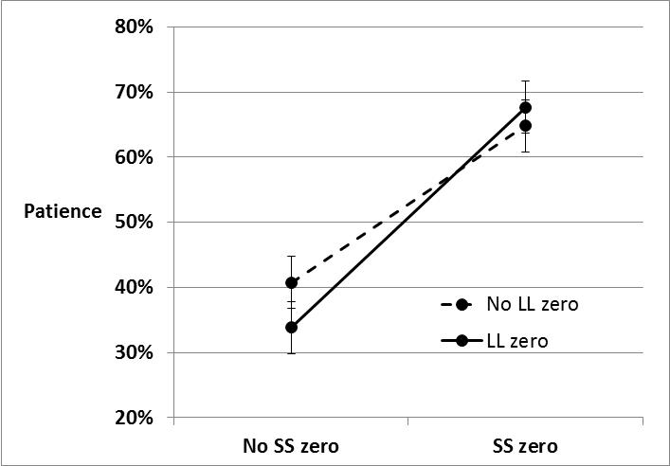
Study 3 Results: Today-SS

Slide 21
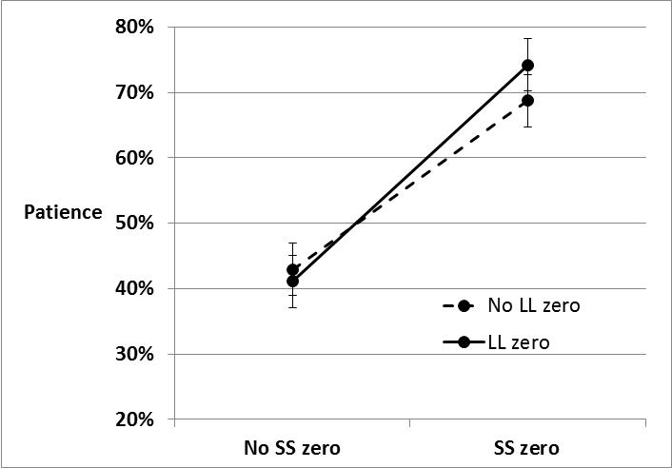
Study 3 Results: Delayed-SS

Slide 22
Mediating, Moderating, & Generalizing
Study 2: Magnitude – robust!
Study 3: “Now” effect – robust!
Study 4: Losses
Study 5a: Within subjects
Study 5b: Lay predictions
Study 6: Thought listings
Study 7: Implicit process measure (RTs)
Study 8: Real outcomes

Slide 23
Study 4: Losses
Losses are discounted less than gains, and eliminate or flip several intertemporal choice phenomena (Appelt, Hardisty, & Weber 2011; Hardisty & Weber 2009; Hardisty, Appelt, & Weber 2013; Thaler 1981)
Choose between receiving: £5.50 today and £0 in 61 days OR £0 today and £7.50 in 61 days
Choose between paying: £5.50 today and £0 in 61 days OR £0 today and £7.50 in 61 days
Predictions: Effect will hold with losses, and patience will be greater for losses

Slide 24
Study 4: Gains

Slide 25
Study 4: Losses

Slide 26
Mediating, Moderating, & Generalizing
Study 2: Magnitude – robust!
Study 3: “Now” effect – robust!
Study 4: Losses – mostly robust
Study 5a: Within subjects
Study 5b: Lay predictions
Study 6: Thought listings
Study 7: Implicit process measure (RTs)
Study 8: Real outcomes

Slide 27
Study 5: Repeated measures (N= 358)
Many framing effects disappear in within subjects designs
Method: 15 Choices made twice.
Order Condition 1: Treatment 🡪 Short Filler 🡪 Hidden control
Order Condition 2: Hidden control 🡪 Short Filler 🡪 Treatment
Notes:
*Study conducted by Julia Langdon and Cathryn Rebak*
LL zero and hidden zero questions are answered the same way, leading to the same choices.
SS zero and Explicit zero questions are also answered the same way.
But Hidden/LL zero differ from Later/Explicit zero.

Slide 28
Study 5: Order 1 Results

Slide 29
Study 5: Order 2 Results

Slide 30
Mediating, Moderating, & Generalizing
Study 2: Magnitude – robust!
Study 3: “Now” effect – robust!
Study 4: Losses – mostly robust
Study 5a: Within subjects – robust!
Study 5b: Lay predictions
Study 6: Thought listings
Study 7: Implicit process measure (RTs)
Study 8: Real outcomes

Slide 31
Study 5: Lay Predictions
After completing both blocks:
£49 today OR £69 in 89 days?
“Previous surveys have found approximately 50% of people prefer each option.”
£49 today and £0 in 89 days OR £69 in 89 days?
“If people saw the choice presented in this manner (instead of the way it was originally presented), do you think they would be more likely, less likely, or equally likely to prefer the larger, later payoff?”
Results: NULL. People do not predict the SS zero effect.

Slide 32
Mediating, Moderating, & Generalizing
Study 2: Magnitude – robust!
Study 3: “Now” effect – robust!
Study 4: Losses – mostly robust
Study 5a: Within subjects – robust!
Study 5b: Lay predictions – people are dumb
Study 6: Thought listings
Study 7: Implicit process measure (RTs)
Study 8: Real outcomes

Slide 33
Study 6: Thought listings
MTurk participants (N=203) listed their thoughts while making their first choice (Appelt, Hardisty, & Weber, 2011; Hardisty, Appelt, & Weber, 2013; Weber et al., 2007)
Thoughts coded by two independent RAs: “Did this thought mention receiving $0 today? (or receiving nothing today?)”
“Did this thought mention receiving $0 in the future? (or receiving nothing in the future?)”
Prediction: Participants will be more likely to mention “$0 in the future” in the SS zero and explicit zero conditions, and this will mediate the results

Slide 34
Study 6: Results
Choice data replicated
Participants listed 3.1 thoughts on average
Less than 1% of thoughts mentioned “$0 now”
Less than 2% of thoughts mentioned “$0 in the future”
No differences between conditions
Conclusion: “nothing” opportunity costs are not an explicit part of most consumers’ decision process

Slide 35
Study 6: Results
“$0 in 29 days was a weird way to put it.”
“Not sure why the $0 in 29 days is included”
“why 0 in 29 days”
“I would rather take the first option, which is $24 today, and $0 in 29 days. I want my money NOW. lol”
“0 in 29 definitely sucks”

Slide 36
Mediating, Moderating, & Generalizing
Study 2: Magnitude – robust!
Study 3: “Now” effect – robust!
Study 4: Losses – mostly robust
Study 5a: Within subjects – robust!
Study 5b: Lay predictions – people are dumb
Study 6: Thought listings – people are dumb, no mediation ☹
Study 7: Implicit process measure (RTs)
Study 8: Real outcomes

Slide 37
Study 7: Choice times
What about unconscious processing? We can measure this through response times.
H1: SS zero brings new information 🡪 Choice times increased.
H2: LL zero brings no information 🡪 Choice times unchanged.
H3: Choice times predict patience, and mediate results
Method: measured response times, logged for analyses, exponentiated for descriptive stats
Choice results: replicate

Slide 38
Choice times

Slide 39
Study 7: Results
$100 now and $0 in one year OR $0 in now and $150 in one year
Aggregate choice times uncorrelated with patience, r(225) = -.01, p = .87
However, if we break it down by which option participants chose, we see:
SS choice times were positively correlated with patience, r(220) = .24, p < .001
LL choice times were negatively correlated with patience, r(219) = -.27, p < .001
SS zero makes impatient choices harder, and patient choices easier

Slide 40
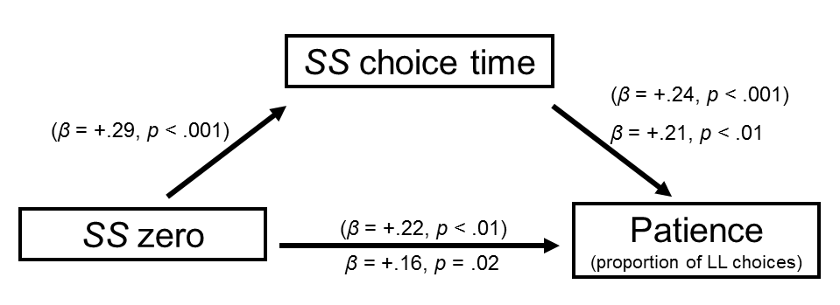
Study 7: Mediation
Bootstrapped mediation test: p < .001

Slide 41
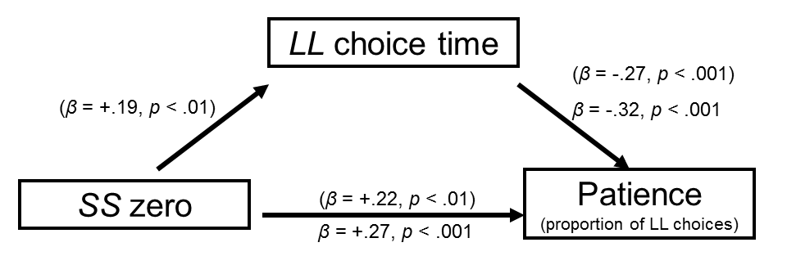
Study 7: Suppression
Bootstrapped supression test: p < .01

Slide 42
Mediating, Moderating, & Generalizing
Study 2: Magnitude – robust!
Study 3: “Now” effect – robust!
Study 4: Losses – mostly robust
Study 5a: Within subjects – robust!
Study 5b: Lay predictions – people are dumb
Study 6: Thought listings – people are dumb
Study 7: Implicit process measure (RTs) – mediation, hell yeah!
Study 8: Real outcomes

Slide 43
Study 8: Real Outcomes
Stanford Students (N=301)
Paid out one trial randomly using an Amazon gift certificate (including immediate payments)
Results: Replicated choice data (slightly smaller effect size)
Results: Effect of SS zero on patience fully mediated by SS choice response times

Slide 44
Study 8: Results
Bootstrapped mediation test: p < .001

Slide 45
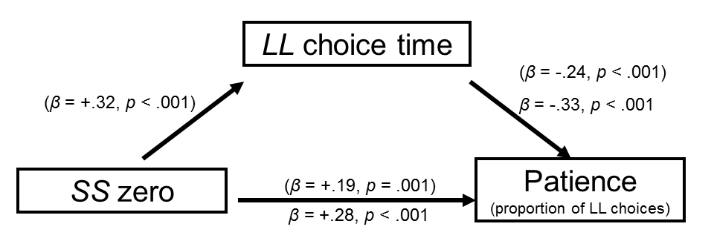
Study 8: Results
Bootstrapped suppression test: p < .001

Slide 46
Real vs Hypothetical Outcomes
 | Hypothetical (Study 1) | Real (Study 8)
Explicit | .64 | .66
Later | .61 | .63
Sooner | .47 | .55
Hidden | .50 | .56
Hidden zero effect (Explicit minus Hidden) | .14 | .10

Slide 47
Mediating, Moderating, & Generalizing
Study 2: Magnitude – robust!
Study 3: “Now” effect – robust!
Study 4: Losses – mostly robust
Study 5a: Within subjects – robust!
Study 5b: Lay predictions – people are dumb
Study 6: Thought listings – people are dumb
Study 7: Implicit process measure (RTs) – mediation, hell yeah!
Study 8: Real outcomes – robust, but slightly reduced

Slide 48
Asymmetry between the impact of SS and LL opportunity costs
Provision for the future makes no inconsiderable demands on our intellectual strength---. The present always gets its rights. It forces itself upon us through our senses. To cry for food when hungry occurs even to a baby. But the future we must anticipate and picture. (Böhm-Bawerk 1891)
But how to picture a future nothing?

Slide 49
3 studies about something
Dale Griffin
Yoonji Shim
Daniel Sun

Slide 50
Project Overview
How can we nudge people towards more energy efficient products?
Partnering with local utility company (BC Hydro)
Many people want to minimize future costs → Let’s make future costs more salient
Three studies of energy cost framing:
10-year cost display
Energy / Dollars x Gain / Loss
Continuous vs Dichotomous

Slide 51
Study 1 methods
Price: $999.95
Estimated Electricity Use (W): 121
Standby energy consumption: 0.2w
Brand: Samsung
Size: 50”
Resolution: 1080p
Price: $749.95
Estimated Electricity Use (W): 181
Standby energy consumption: 0.4w
Brand: Samsung
Size: 50”
Resolution: 1080p

Slide 52
Study 1 methods
Price: $999.95
10-year estimated cost: $600
Estimated Electricity Use (W): 121
Standby energy consumption: 0.2w
Brand: Samsung
Size: 50”
Resolution: 1080p
Price: $749.95
10-year estimated cost: $1,000
Estimated Electricity Use (W): 181
Standby energy consumption: 0.4w
Brand: Samsung
Size: 50”
Resolution: 1080p

Slide 53
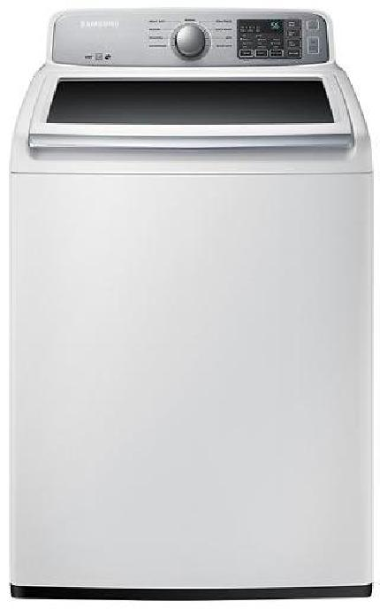
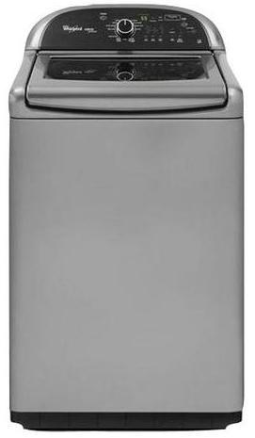
Price: $629.99
Estimated Yearly Electricity Use (kWh): 169
Model: 4.5 Cu. Ft. 9 cycle Top Load Washer
Brand: Samsung
Price: $899.99
Estimated Yearly Electricity Use (kWh): 150
Model: 4.8 Cu. Ft. 13 cycle Top Load Washer
Brand: Whirlpool

Slide 54
Price: $629.99
10-year estimated cost: $180
Estimated Yearly Electricity Use (kWh): 169
Model: 4.5 Cu. Ft. 9 cycle Top Load Washer
Brand: Samsung
Price: $899.99
10-year estimated cost: $100
Estimated Yearly Electricity Use (kWh): 150
Model: 4.8 Cu. Ft. 13 cycle Top Load Washer
Brand: Whirlpool

Slide 55
Study 1 Results: Clean

Slide 56
Study 1 Results: Real

Slide 57
Study 1: Why? (Mediation)
Not discount rates or environmental attitudes
Goal matching?
Goal activation?
Increased time horizon?
Cost under-estimation?
Other ideas?
How to measure these?

Slide 58
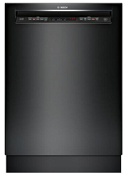
Study 2: Methods
Price: $764.99
Estimated Yearly Dollar [Energy] Savings [Cost]: $27 [259 kWh]
Interior Capacity: Up to 16 place settings
Dishwasher Type: Full-size built-in
Brand: Bosch
Price: $649.99
Estimated Yearly Dollar [Energy] Savings [Cost]: $0 [279 kWh]
Interior Capacity: Up to 14 place settings
Dishwasher Type: Full-size built-in
Brand: LG

Slide 59
Study 2: Results (Clean)

Slide 60
Study 2: Results (Real)

Slide 61
Study 2: Why? (Mediation)
Not discounting, environmental attitudes, or political orientation
Loss aversion?
Construal level theory?
Goal matching/activation?
Other ideas?

Slide 62
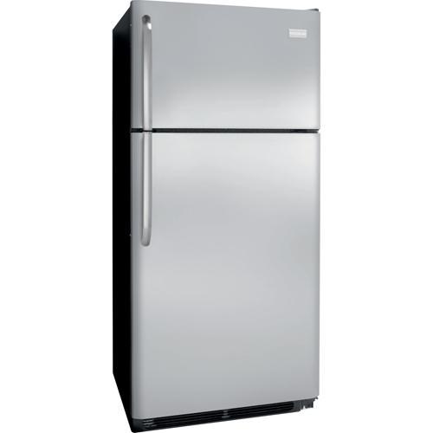
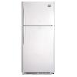
Study 3: Methods
Price: $799.97
[Energy Star Certified: No]
[Energy Usage (kWh/year): 479]
Top mount refrigerator
18.2 Cu. Ft.
Price: $799.97
[Energy Star Certified: Yes]
[Energy Usage (kWh/year): 383]
Top mount refrigerator
18.2 Cu. Ft.

Slide 63
Study 3: Results

Slide 64
Study 3: Why? (Mediation)
Not maximizing/satisficing
Translated attributes?
Goals?
Other ideas?

Slide 65
Going forward
Test with Vancouver residential sample
Explore mediators
Compare with & against existing methods (social norms, defaults, etc)
Field studies & implementation

Slide 66
Thank You!

